Slide 1
Bizzxe 2.0
Supply Chain
Sales & Marketing
Quality Assurance
Administration
Manufacturing
Finance
Bizzxe 2.0
ERP

Slide 2







Bizzxe 2.0
Main Application
Auxiliary Application
Intelligent
Capturing Data
Offline
Online
Main Data Processing
Capturing Data Online
on the ground
Converting data in to
insight

Slide 3
Manufacturing Process Bizzxe 2.0
Data Setup
Production Planning
Pre-Execution
Execution
Post-Execution

Slide 4


Data Setup
Quality Management
Master Data
Manufacturing
Master Data
Material Identification
Master Data
Customer Demand
Master Data
Master Entities
Master Entities
Master Entities
Master Entities
Interacting Entities
Interacting Entities
Interacting Entities
Interacting Entities
Sample Collection
Quality Control
Quality Assurance
Product Release
Route Master
Raw material
Customer Demand

Slide 5





Production Planning
Process Order Initialization
Process Order Authorization
Route Allocation
Process Order Qty Identification
Scheduling
Shift Allocation
Generating MRN
Notifying QA offices
Notifying Warehouse Terminal
Notifying Production Line Terminal

Slide 6

Pre Execution
Line Initialization
Start Production
Labour Allocation
Material Receiving
Line Check List
Execution Start
Create Cycle No

Slide 7
Execution
Excess MRN
Machine Adjustment
Operation Time Management
Output Tracking & Cycle Creation
Shift Adjustment
Quality Control / Assurance
Activity Tracking
Item Transfer

Slide 8
Post Execution
Finished Goods Update
Labour Roster Update
Item Transfer

Slide 9

Quality Management
Master Entities
Interacting Entities

Slide 10

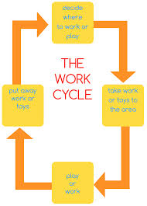

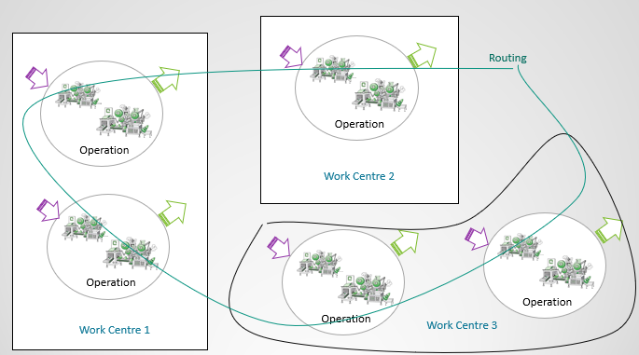

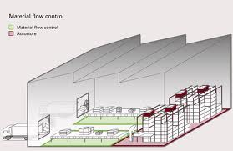

Manufacturing Concept
Machine
Route
This will show what sub-components are needed in the manufacture of the end product and the quantity of those items
Work cycle
Sequence of activities and movements which are repeated with little or no variation each time the job is performed.
Operation
Individual processes a company engages in to produce a finished goods or WIP
Work Centre
Section of a production facility where all tasks associated with a particular process
Operation Template
Standard sequence of operations to produce a finished good or WIP

Slide 11
Manufacturing Scope
Interacting Entities
Planning Entities
Master Entities
Execution Entities

Slide 12
Route Master
Time Type
Machine
Overhead
Cooperate Title
Work center
Operation
Routing Standard Template
BOM
Route
Activity
Labour Pool

Slide 13
How does Process Order Qty Identification work
Customer
Demand
Consolidate the
Customer
Demand By Selected Product
Customer | Item | Qty
CJPP | Butter | 1000 Ctn
CJPP | UHT-Dawn | 5000 Ctn
Au Bon Marche | UHT-Dawn | 1000 Ctn
Selected Product = UHT - Dawn
Customer | Item | Qty
CJPP | UHT-Dawn | 5000 Ctn
Au Bon Marche | UHT-Dawn | 1000 Ctn
Qty to be produced = 6000 Ctn

Slide 14


How does MRN autogenerating work
BOM
Route
Process Order
MRN Requirement
Raw material | UOM | QTY | UOM Type
MILK POWDER IFCMP | Kilo Grams | 0.10 | Production UOM
UHT A885695101 UHT MPM | Meters | 0.2732 | Production UOM
UHT Re-Cap Glue Hot Melt | Kilo Grams | 0.0002 | Production UOM
Raw material | UOM | BOM QTY | Process Order Qty | Req Qty
MILK POWDER IFCMP | Kilo Grams | 0.10 | 6000 | 600
UHT A885695101 UHT MPM | Meters | 0.0272 | 6000 | 163.2
UHT Re-Cap Glue Hot Melt | Kilo Grams | 0.0002 | 6000 | 1.2
Item Store Mapping
Item | Store | Type
UHT A885695101 UHT MPM | Main Store | Is Production Store
UHT Re-Cap Glue Hot Melt | Sub Store | Is Production Store
MRN | Item | UOM | BOM QTY | Store | Req Qty
MRN1 | MILK POWDER IFCMP | Kilo Grams | 0.10 | Main Store | 600
MRN1 | UHT A885695101 UHT MPM | Meters | 0.0272 | Main Store | 163.2
MRN2 | UHT Re-Cap Glue Hot Melt | Kilo Grams | 0.0002 | Sub Store | 1.2

Slide 15
How does raw material issuing work
MRN
Raw Material
Store
Production
Store
Production
Line Store

Slide 16
How does QA notification work
QA Template
Main Application
Entities
QA Officers List
Template
Configuration
QA Offices
Template | Officer Name
Dawn Reconstituted Milk | Name 1
Dawn Reconstituted Milk | Name 2
Template | Transaction Type | Transaction
Dawn Reconstituted Milk | Route | Dawn Route
Dawn Ingredient release checklist | Route | Dawn Route
Label Check | GSRN | GSRN 1

Slide 17
How does terminal notification work
Terminal Registration
Terminal Workflow
Message Mapping
Workflow Entity
Mapping
Terminal | WF Message
Dawn Terminal 01 | WF1 - Initialization Message
Dawn Terminal 02 | WF1 - Execution Message
Warehouse Terminal 01 | WF1 - MRN Message
Workflow | Entity
WF1 - Dawn Automation WF | Dawn Route
WF2 - Butter Automation WF | Butter Route

Slide 18

How does labour allocation work
Process Order
Schedule
Labour Pool
Labour Allocation
Process Order | Labour Pool | Labour
Dawn PO 01 | Dawn Pool | Labour 1
Dawn PO 01 | Dawn Pool | Labour 2
Process Order | Labour
Dawn PO 01 | Labour 1
Dawn PO 01 | Labour 2
Dawn PO 01 | Labour 3
Labour
Labour 3
Labour 4
Labour Master Entities

Slide 19
How does material receiving work
MRN
Process Order
Item Issue
Approve Process Order
Item Issue
Generate transfer and show on item transfer mobile App

Slide 20
How does line check list work
Line Check
List Master
Route
Process Order
Line Check List
Route
Pre Execution
Line Check List

Slide 21


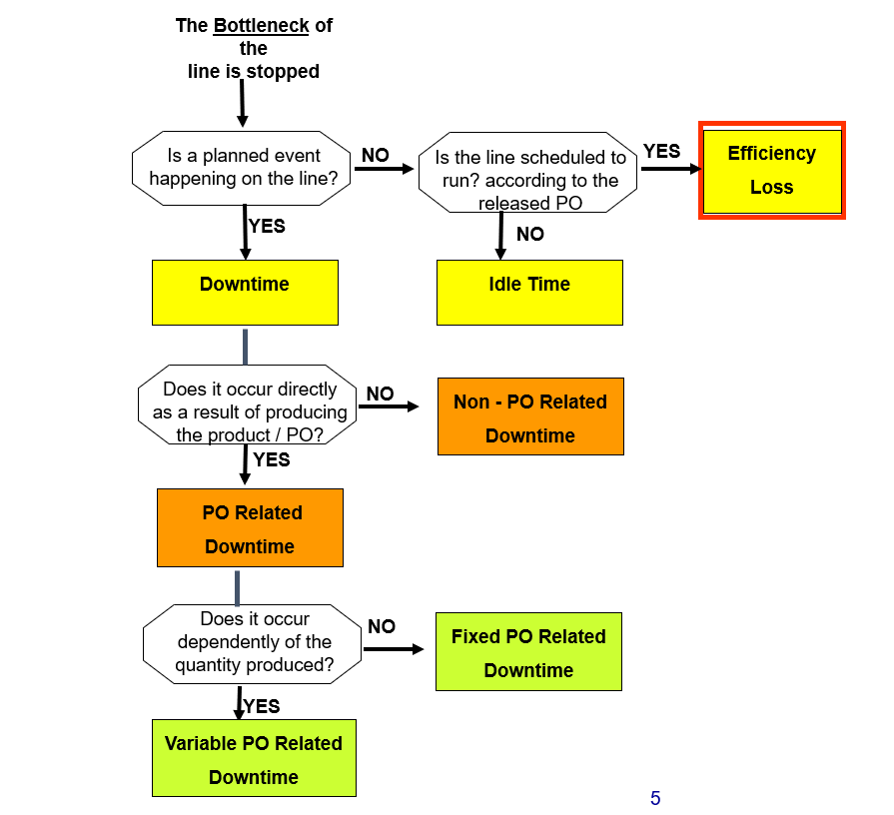

How does operation time management work
Time Nature Master
Pause
Play
Capture The Reason
Record the production
paused time duration
Efficiency Calculation
Stop
Machine Time Type
Capture The Reason
Finished goods update

Slide 22





How does Output tracking & Cycle creation work
Output Counting
Pallet Label Printing
Route
Cyclewise Qty
Output Product
Count, Identified Pallet Qty for Particular Main Output and record
Count, Identified Cycle Qty for Particular Main Output
Print pallet label
Generate new cycle

Slide 23

How does activity tracking work
Count Activity
Route
Activity
Count the identified activity and record

Slide 24
How does output tracking work
Finished Goods Update
Cost Component | Source | Formulary
Direct Labour | From Labour Allocation | Labour Standard Rate * Number Of Hours
Direct Material | From Material Usage
Fixed Overhead | From identified overhead on Route output level | Standard cost for the overhead will be used through apportion formula
Variable Overhead | From identified overhead on Route output level | Standard cost for the overhead will be used through apportion formula
Finished Goods
Shift Close
Finished Goods QTY
Finished Goods Cost
(Issued material – Leftover Material ) * Batch Wise Average Cost
Raw material
$
Cycle Qty | Source | Qty
Cycle 1 | Pallet printing Output Tracking App | 100
Cycle 2 | Pallet printing Output Tracking App | 100
Cycle 3 | Pallet printing Output Tracking App | 80
= 280
Qty
Ledger Update
Generate Transfer Note to the given QA store for output

Slide 25
How does Item transfer work
Finished good update
and store the WIP
on the production line stores
Generate transfer and show on item transfer mobile App
Initiate WIP transfer

Slide 26
How does labour roster update work
Update total hours worked
Process Order Execution
Labour Allocation
Allocated Labour List

Slide 27
Material Identification
Interacting Entities
Master Entities

Slide 28
Customer Demand
Interacting Entities

